Slide 1

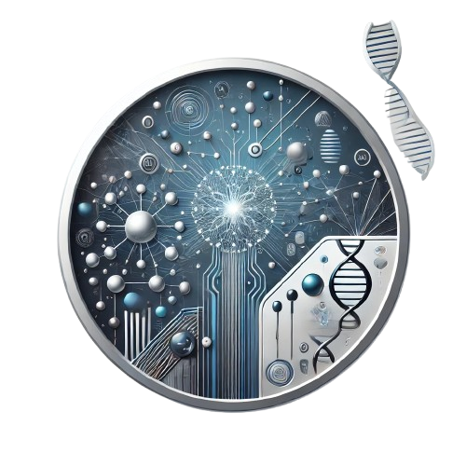
Leveraging ANN for Targeted Drug Sensitivity Prediction on GDSC Data
DHANUSH A 4MT21CS046
DHANUSH S SHETTY 4MT21CS047
K SAHANA RAO 4MT21CS062
KARTHIK U SHETTIGAR 4MT21CS064
Under the guidance of
Ms. Suma K
Asst. Professor,
Department of Computer Science and Engineering
Dept. of CSE,MITE

Slide 2
Major-project
Contents
Introduction
Motivation
Literature Review
Proposed Solution
Block Diagram
Expected Outcomes
Conclusion
Dept. of CSE,MITE

Slide 3
Introduction
Major-project
Project Overview:
Predict the sensitivity of cancer cell lines to anti-cancer drugs.
Utilize the Genomics of Drug Sensitivity in Cancer (GDSC) dataset.
Analyze genomic features of cancer cell lines and molecular properties of drugs.
Develop a machine learning model to accurately predict drug sensitivity (IC50 values).
Gain insights into personalized cancer treatments.
Dept. of CSE,MITE

Slide 4
Motivation
Mini-project
a. Significance of the Problem
Cancer treatment is challenging due to the variability in how different patients and cancer cell lines respond to the same drug. This unpredictability often leads to ineffective treatments and adverse effects. There is an urgent need for predictive models that can help personalize treatments based on the genetic profile of the cancer cells.
b. Impact on Specific Domain or Audience
The project primarily impacts the field of oncology and personalized medicine. By using genomic data to predict drug responses, oncologists can potentially tailor treatments to individual patients, improving efficacy and minimizing side effects.
c. Real-World Examples
According to the World Health Organization (WHO), cancer is one of the leading causes of death worldwide, with approximately 10 million deaths in 2023. Predictive models like this can significantly reduce trial-and-error approaches in chemotherapy, leading to better patient outcomes.
Dept. of CSE,MITE

Slide 5
Literature Review
Major-project
1. Discovering the Mechanism of Action of Drugs with a Sparse Explainable Network - Katyna Sada Del Reala, Angel Rubioa (2023)
This study introduces SparseGO, an explainable neural network for predicting drug responses in cancer, using gene expression data from datasets like GDSC1 and GDSC2.
Strengths: Offers high interpretability of drug mechanisms.
Weaknesses: High computational requirements.
2. Deep Learning Methods for Drug Response Prediction in Cancer: Predominant and emerging trends - Alexander Partin, Thomas S. Brettin, Yitan Zhu, et al. (2023)
This paper reviews 61 deep learning models that predict cancer response to drug treatments using data from sources like GDSC. It focuses on analyzing deep learning architectures and data representations used in predicting responses to individual drugs.
Strengths: Provides a comprehensive review of various deep learning models and highlights prevalent and emerging trends in the field.
Weaknesses: The diversity of approaches and lack of standardized evaluation frameworks make it difficult to compare model performance .
Dept. of CSE,MITE

Slide 6
Literature Review
Major-project
3. Machine learning approaches to predict drug efficacy and toxicity in oncology - Bara A. Badwan, Gerry Liaropoulos, Efthymios Kyrodimos, Dimitrios Skaltsas, Aristotelis Tsirigos. (2023)
This paper presents an overview of machine learning techniques used to predict drug sensitivity in cancer cell lines. The study evaluates different models and data sources like GDSC for predicting cell responses to drugs.
Strengths: Offers an extensive evaluation of machine learning techniques for drug sensitivity prediction, highlighting model effectiveness.
Weaknesses: High computational complexity and challenges with integrating multi-omics data limit scalability and application .
4 Predicting Drug Response and Synergy Using a Deep Learning Model of Human Cancer Cells - Brent M. Kuenzi, Jisoo Park, Samson H. Fong, (2020)
The authors discuss using machine learning models, like random forests, to predict drug sensitivity based on genomic data from the GDSC dataset.
Strengths: Accurate predictions from genomic data.
Weaknesses: Limited generalizability across cancer types.
Dept. of CSE,MITE

Slide 7
Proposed Solution
Major-project
a. Approach
In this project, we propose to build a machine learning model that predicts the IC50 values (drug sensitivity) of cancer cell lines based on their genomic features and drug properties. The dataset includes information from GDSC2-dataset.csv, Cell_Lines_Details.xlsx, and Compounds-annotation.csv. The combined data will be preprocessed, encoded, and used to train a predictive model.
b. Main Features and Innovations
Integration of Genomic and Drug Data: This project will combine genomic features (mutations, gene expression, etc.) with drug properties (targets, pathways) to provide a holistic view of drug responses.
Predictive Modeling: Using deep learning algorithms like Artificial Neural Networks (ANN) the model will predict drug sensitivity (IC50 values) based on these features.
Dept. of CSE,MITE

Slide 8
Proposed Solution
Major-project
c. Tools and Technologies
Programming Language:Python Machine Learning
Libraries: Scikit-learn, TensorFlow/PyTorch (for ANN)
Data Handling: Pandas, NumPy
Visualization: Matplotlib, Seaborn
These choices are appropriate as they offer flexibility, performance, and the necessary tools to preprocess large datasets, build models, and visualize results.
Dept. of CSE,MITE

Slide 9
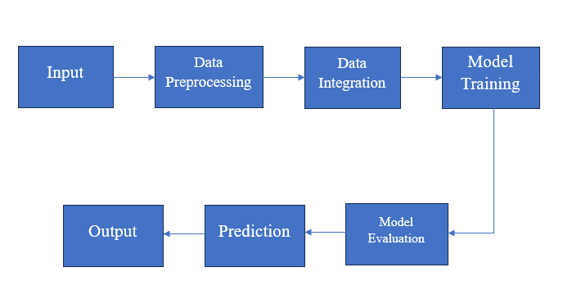
Block Diagram
Major-project
Dept. of CSE,MITE

Slide 10
Block Diagram
Major-project
Input:
Genomic features (e.g., mutations, gene expression) from cancer cell lines
Drug properties (e.g., targets, pathways)
Data Preprocessing:
Data cleaning and normalization
Feature engineering (e.g., creating new features)
Data Integration:
Combine genomic and drug data into a single dataset
Model Training:
Train the model on the combined dataset to learn the relationship between genomic features, drug properties, and drug sensitivity
Model Evaluation:
Assess the model's performance using appropriate metrics (e.g., accuracy, precision, recall, F1-score)
Prediction:
Use the trained model to predict drug sensitivity (IC50 values) for new cancer cell lines and drugs
Output:
Predicted drug sensitivity values
Dept. of CSE,MITE

Slide 11
Expected Outcomes
Major-project
a. Tangible Outcomes
Predictive Model: A machine learning model capable of predicting drug sensitivity based on the genomic and drug properties of cancer cell lines.
Final Report: A detailed report documenting the methodology, results, and findings of the project.
Presentation: A visual presentation of the project outcomes, including key results and insights.
b. Inputs and Outputs
Input: The input will consist of the combined genomic and drug datasets, including mutations, gene expression, and drug properties.
Output: The output will be predicted IC50 values (drug sensitivity) for different drug-cell line combinations.
Dept. of CSE,MITE

Slide 12
Conclusion
Major-project
In summary, this project, Major Project: Leveraging ANN for Targeted Drug Sensitivity Prediction on GDSC Data, addresses the need for personalized cancer treatment by predicting drug sensitivity based on genomic features. By integrating genomic data with drug properties and utilizing machine learning techniques, the project aims to improve the accuracy of drug response predictions. The proposed solution combines innovative data integration methods with cutting-edge machine learning algorithms to create a powerful predictive model that can potentially revolutionize cancer therapy decision-making.
Dept. of CSE,MITE

Slide 13
THANK YOU

